Slide 1
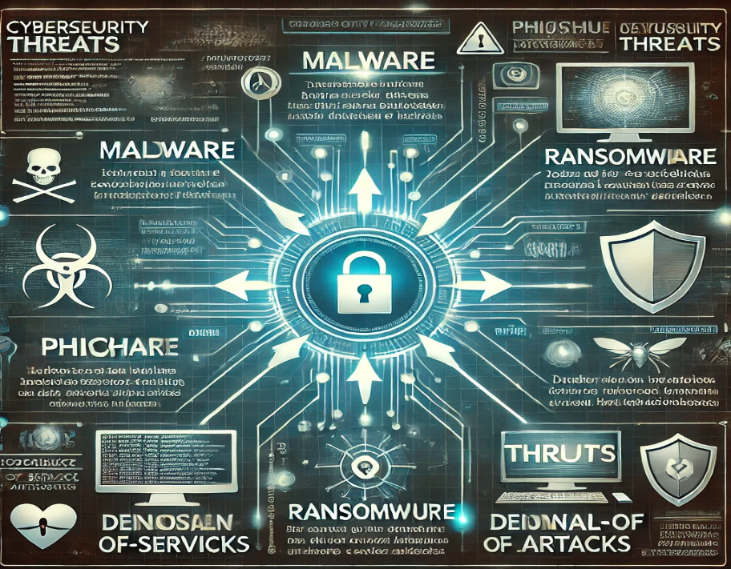
Cyber Security Threats
Problem overview:
The problem this report examines is the rise in cybersecurity attacks and the increasing need for stronger defense mechanisms to protect sensitive data and digital infrastructure.
Solution:
Multi-layered Framework
Increasing Awareness
Criteria:
Maintenance
Performance
Cost
Figure 1 Multilevel Cyber Security Threats [1]
[1] | [Online]. Available: https://www.gettyimages.ca/photos/cybersecurity-threat-intelligence. [Accessed 15 2 2025].

Slide 2
Bibliography
[1] | [Online]. Available: https://www.gettyimages.ca/photos/cybersecurity-threat-intelligence. [Accessed 15 2 2025].

